Slide 1
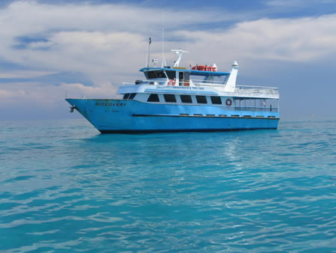
Whose _____ is this?
It’s mine.
Is this your _____?
Yes, it’s mine.
No, it’s not mine.

Slide 2
Let’s write!

Slide 3
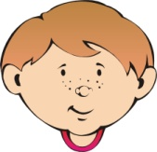
 | eraser | . | yours | mine | blue | yellow
pencil
pencil
Whose _________ is this?
.
blue
That’s not _____. Mine’s ____
mine

Slide 4
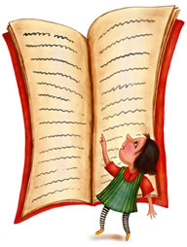
book | coat | ? | yours | mine | big | small
Whose _____ is this _
book
?
That’s not _____. Mine’s _____.
mine
small

Slide 5
banana | coat | ? | . | mine | green | yellow
Whose ________ ___ _____
That’s ____ _____. ____ _____
_______________________?
___________. _____________.

Slide 6
Find the mistakes!
Hellllo class!
Hello Teecher!
How are you today.
I’m Fine. Thank YoU. And u?
I’m gud.

Slide 7
Find the mistakes!
Min! Is your apple this?
No, it’s mine.
apple Whose is this?
apple Lisa’s It’s!
Lisa, here you are

Slide 8
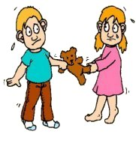
Listen and write
Whose _________________?
2. My __________________.
3. It’s not yours. It’s _________.

