Slide 1
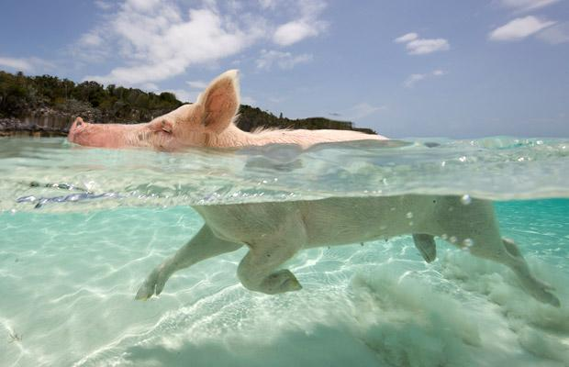
What is he ______?
doing
He is _________.
swimming

Slide 2
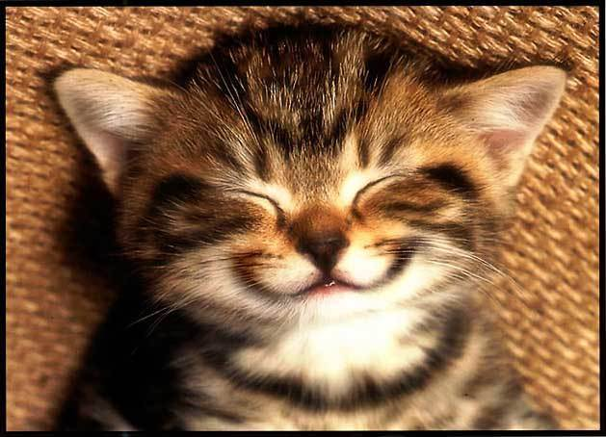
_____ __ she doing?
What is
She is _________.
smiling

Slide 3
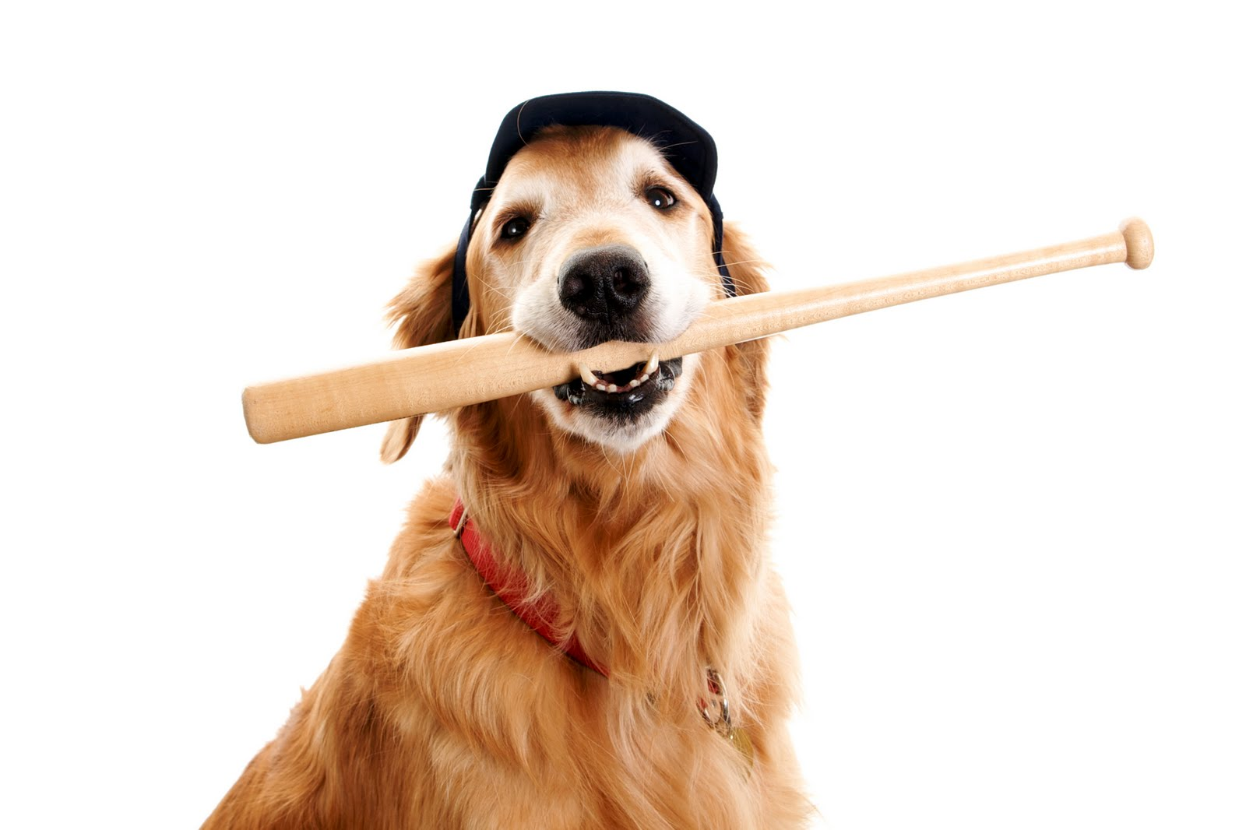
What __ __ doing?
is he
He is _______ ______.
playing baseball

Slide 4
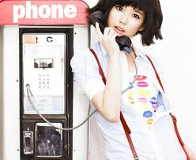
What is IU _____?
doing
She is _________.
talking

Slide 5
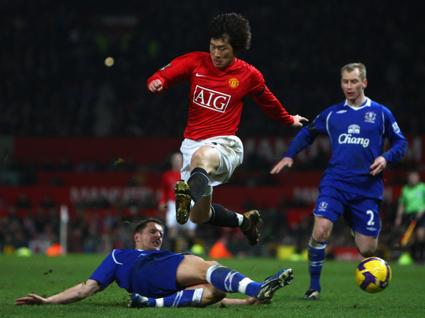
doing
What is Pak Ji Sung _____?
He is
_____ and
______.
running
jumping

Slide 6
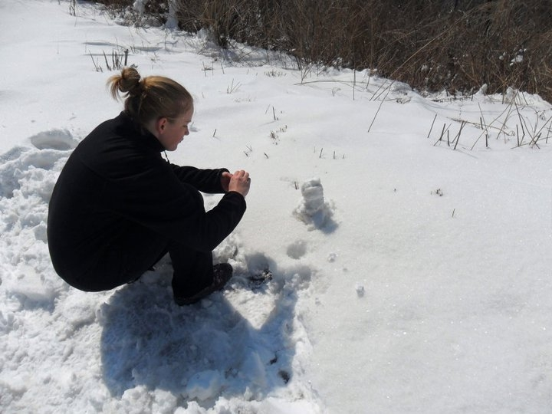
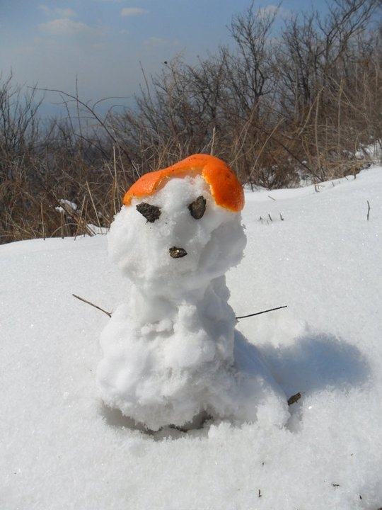
What __ T. Una ____?
is
doing
She is _____ a _____.
making
snowman

