Slide 1
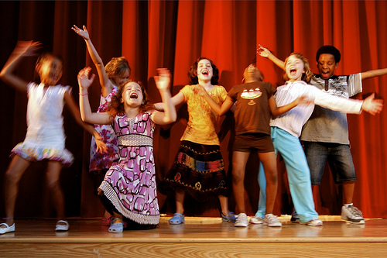
Role Play time!

Slide 2
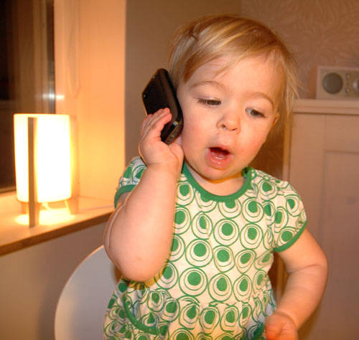
Make a dialogue:
Mom, what are you doing?
I’m running.
I’m _____ing.

Slide 3
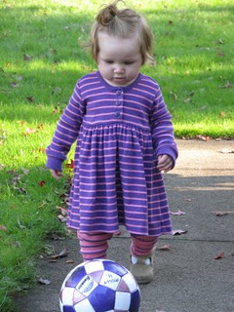
Make a dialogue:
Wow! What are you doing?
I’m _____ing the ball.
I’m kicking the ball.

Slide 4
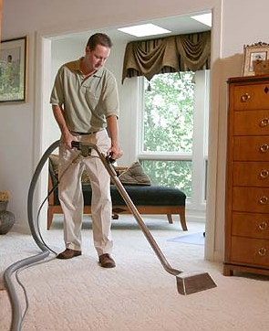
Make a dialogue:
Hello Tom.
I’m cleaning the floor.
I’m _____ing the floor.
Daddy! What are you doing?
Hi Dad!

Slide 5
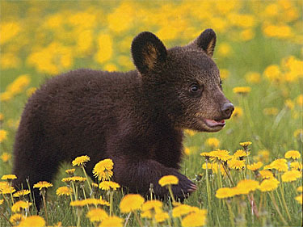
Make a dialogue:
Dad! What ____ ___ _______?
I’m ______.

