Slide 1

Welcome to English class!
It’s nice to meet all of you!

Slide 2

What’s your name?
My name is Una Hogan.
Please call me Teacher-Una!
I’ve been in Korea for 2 years.

Slide 3
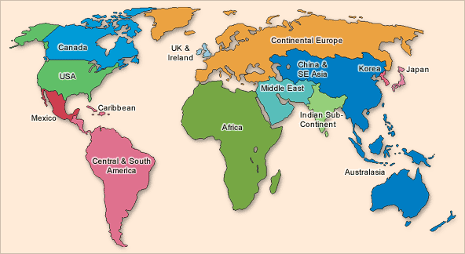
Where are you from?
I am from Ireland.

Slide 4
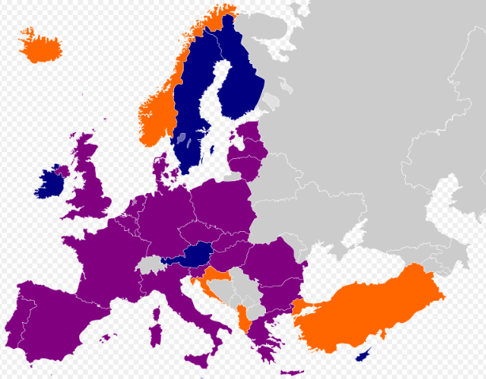
Where are you from?
Ireland is in Europe.

Slide 5
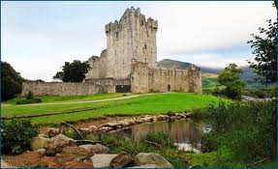
Ireland
Ireland is very beautiful.

Slide 6
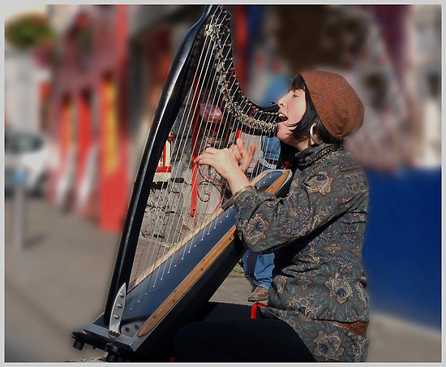
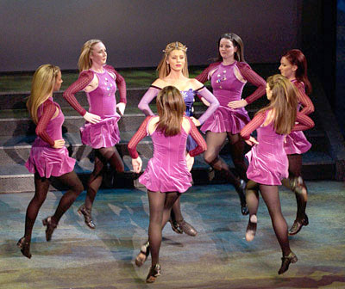

Ireland
Irish people like music and dancing.

Slide 7
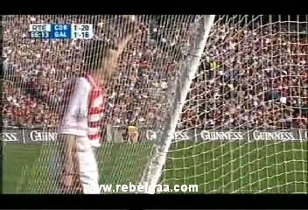
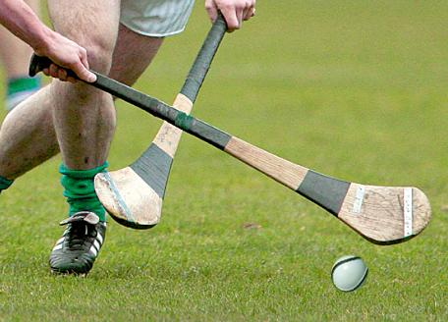
Ireland
Ireland has it’s own sports like hurling.

Slide 8
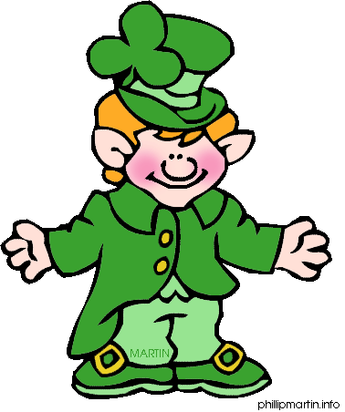
Ireland
This is a leprechaun from Ireland!

Slide 9
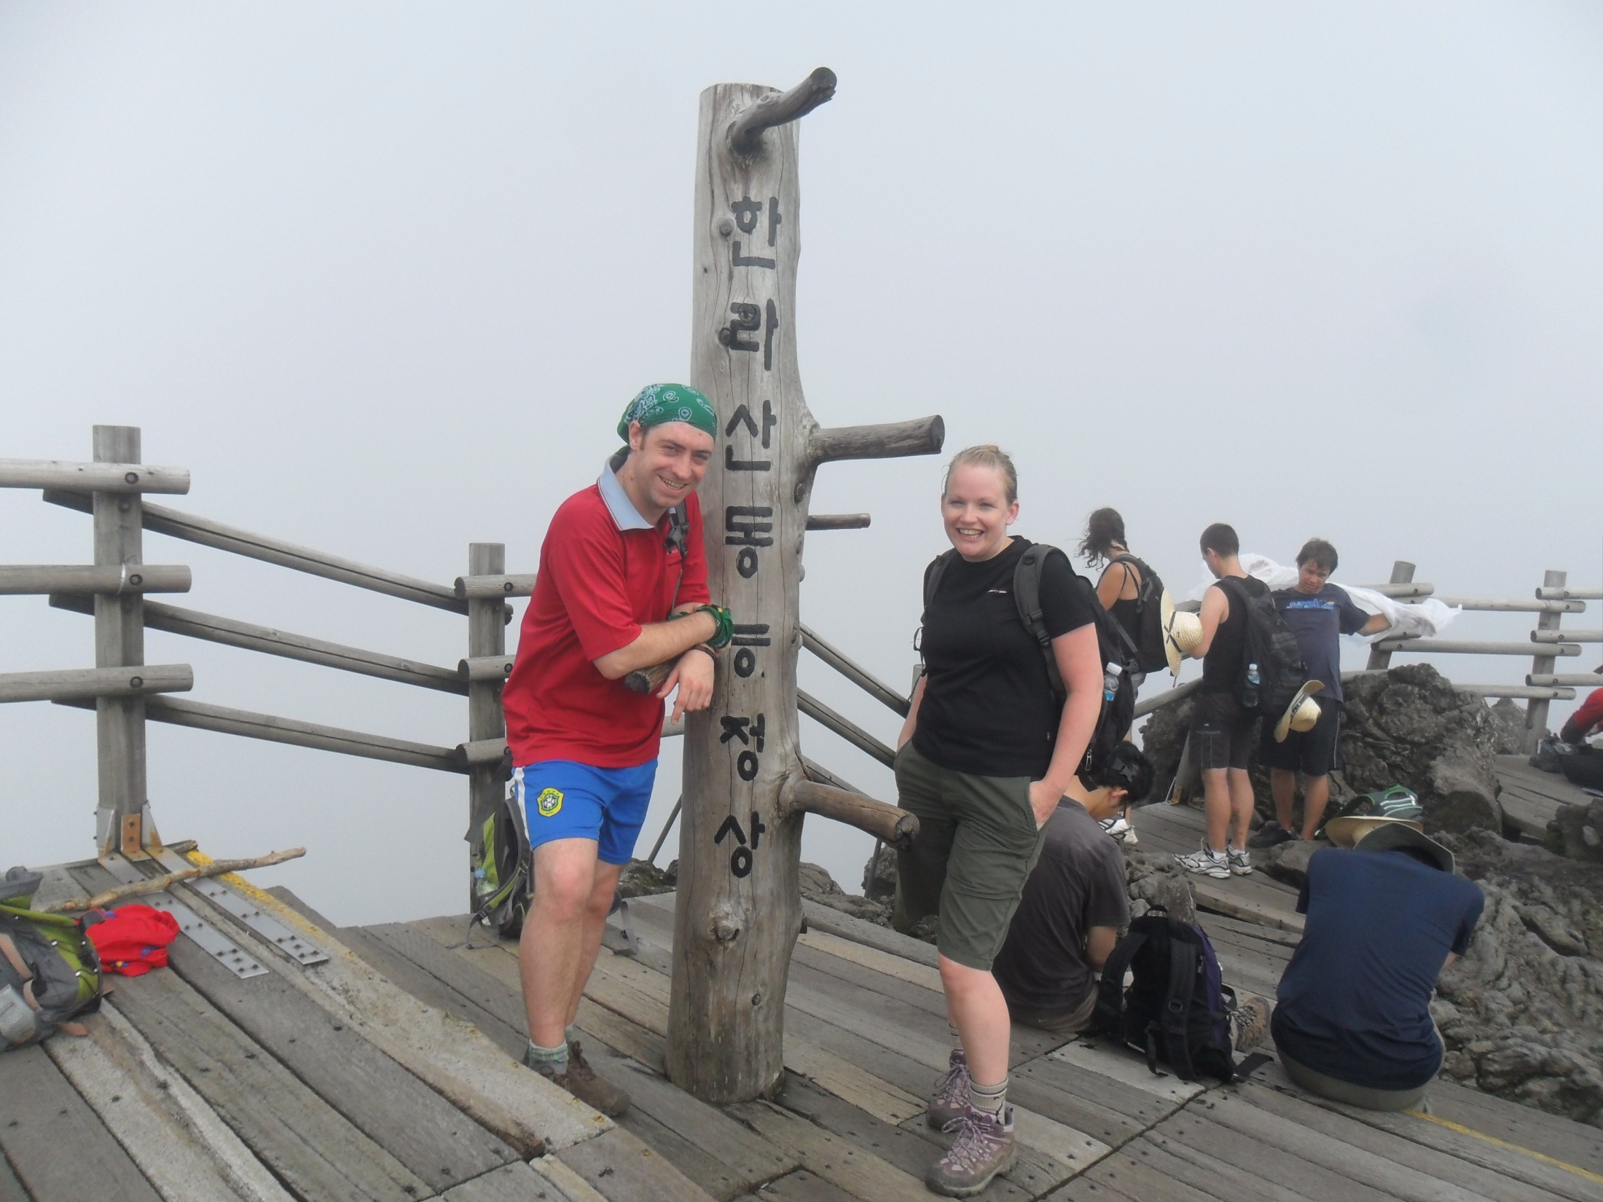
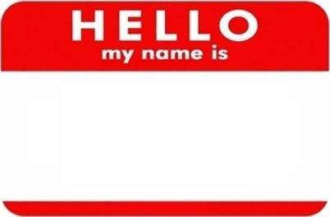
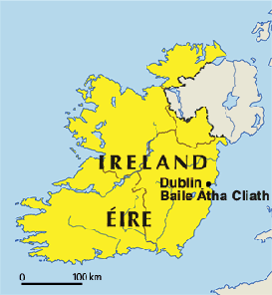
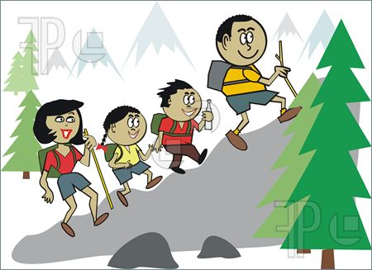
All about me:
My name isTeacher-Una.
Una Teacher
I’m from Ireland.
I am 29 years old!
I like hiking mountains.

Slide 10
1-2-3-4 Snowball Game!
1. My name is ______________.
2. I’m from _____________.
3. I am __________ years old.
4. I like _____________.

Slide 11

Classroom
Rules

Slide 12
Rule 1:
Listen to the teachers

Slide 13
Rule 2:
Raise your hand

Slide 14
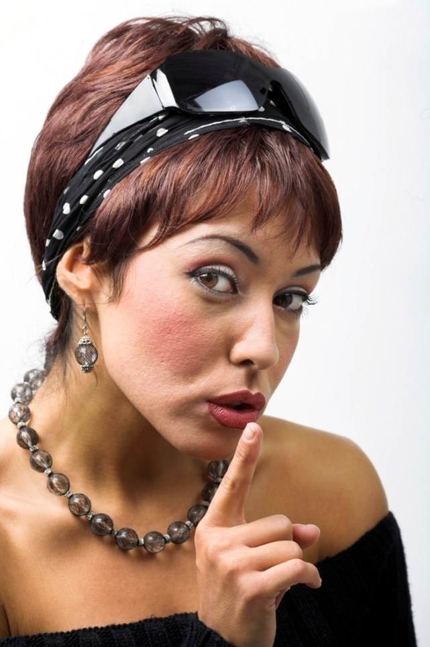
Rule 3:
Quiet Voices

Slide 15

Rule 4:
Try Hard

Slide 16

Rule 5:
Don’t worry!
Learning English is fun!

