Slide 1
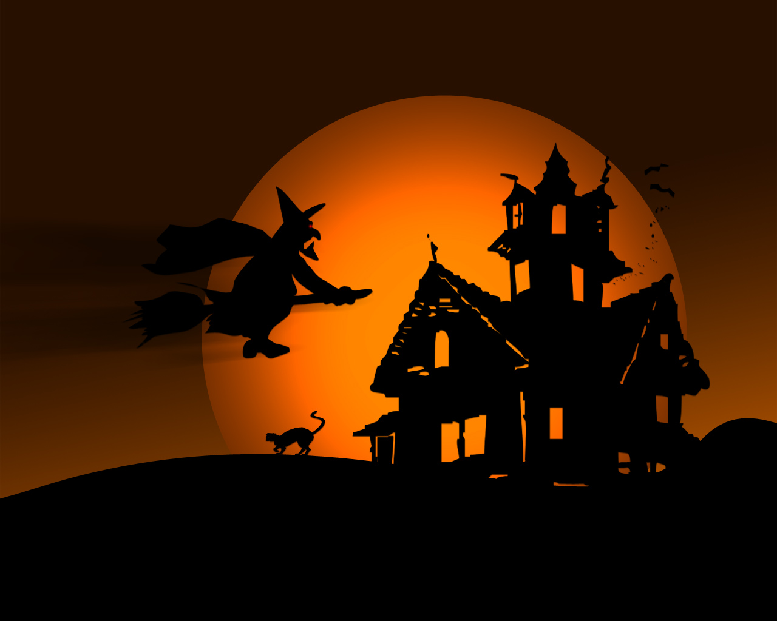
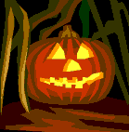
HALLOWEEN

Slide 2
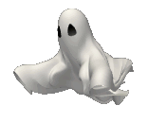
Halloween started a long time ago in Ireland (Samhain).
Halloween started a long time ago in Ireland.
People believed that the dead came alive on October 31st.
People believed that the dead came alive for 1 night- October 31st.

Slide 3
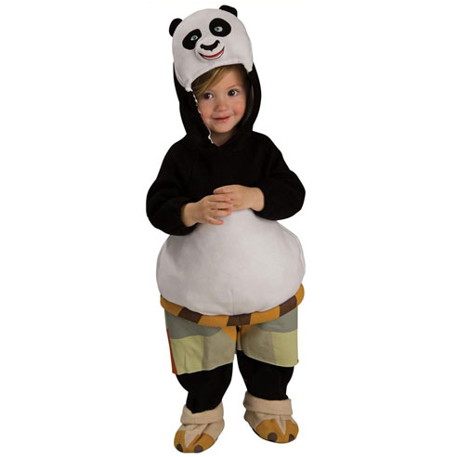
Costumes
Some children dress-up cute!

Slide 4
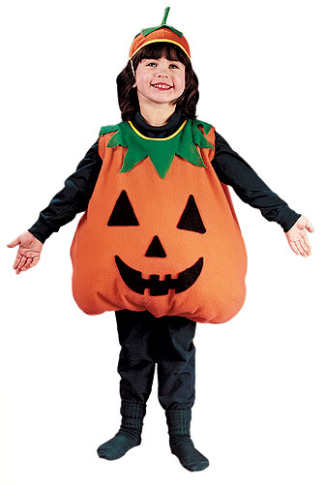
Costumes
Some children dress-up funny!

Slide 5
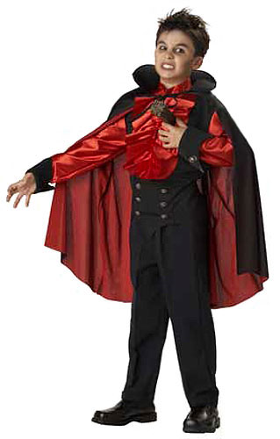
Costumes
Some children dress-up scary!

Slide 6
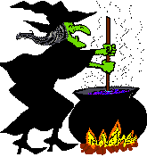
Witch

Slide 7
Ghost

Slide 8
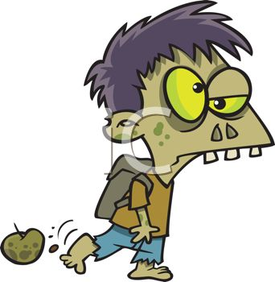
Zombie

Slide 9
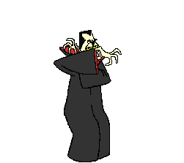
Dracula

Slide 10
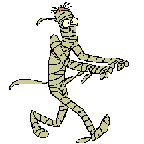
Mummy

Slide 11
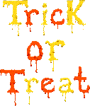
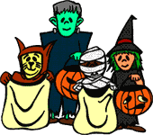
Trick or treat!

Slide 12
Trick or treat
Children ask their neighbors for candy.
They stay awake very late!

Slide 13
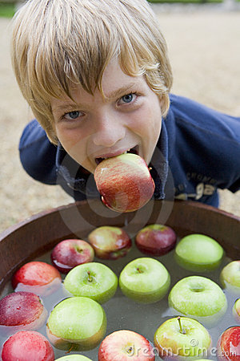
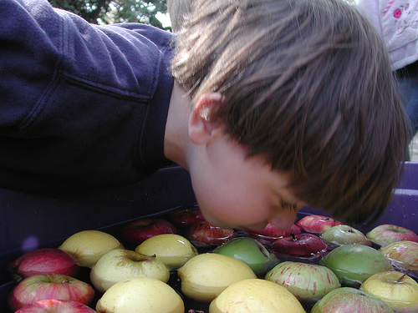
Halloween Games
Children try to grab an apple, only using their mouth!

Slide 14
Halloween Games
Children try to get a candy out of the flour using their face!

Slide 15
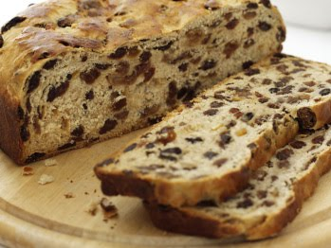
Halloween Food
This is barm brack! A ring is baked in the cake. If you get the ring in your piece, you will be the first to be married!

Slide 16
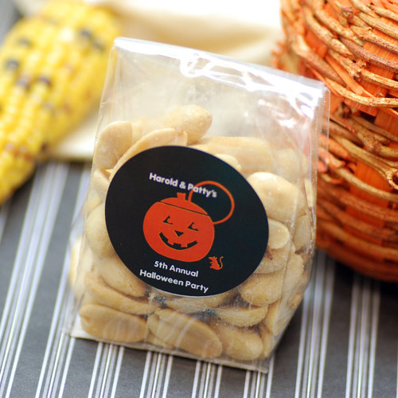
Halloween Food
We eat a lot of nuts at Halloween.

Slide 17
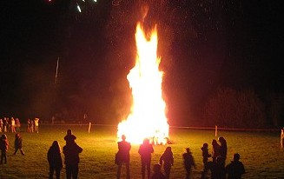
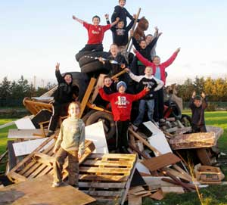
Bonfire

Slide 18
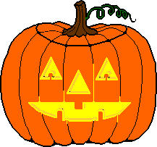
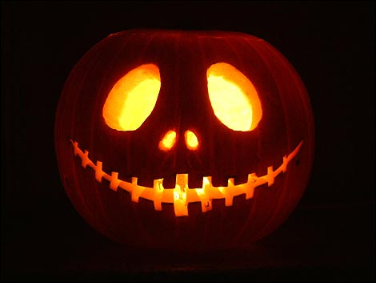
Jack o’ lantern
People make these out of pumpkins because of an old ghost story about a man with no head!

Slide 19
Let’s listen to a Halloween song!
(Close your eyes if you get scared)

Slide 21
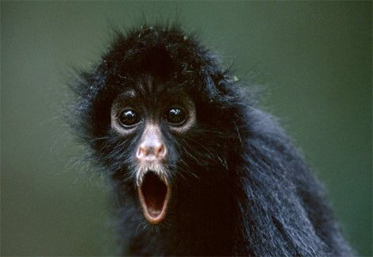
Boo!

