Slide 1
Let’s sing!

Slide 2
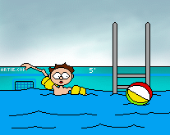
We are going swimming.
Can you join us?

Slide 3
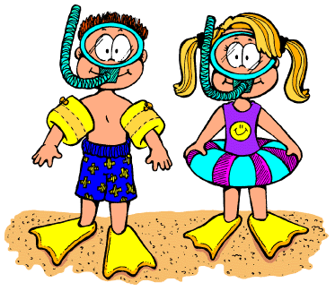
We are going swimming.
Would you like to come?

Slide 4
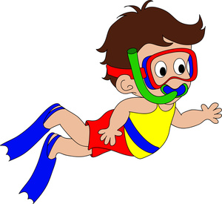
Yes, sure; that sounds fun.
I like swimming.
I’d like to come.

Slide 5
Yes, sure;
that sounds great.
I really cannot wait.

Slide 6
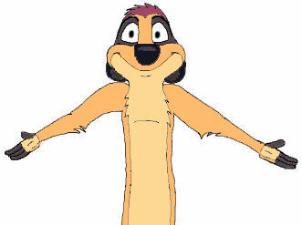
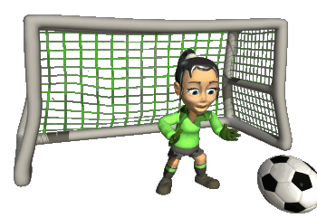
We are playing soccer.
Can you join us?

Slide 7
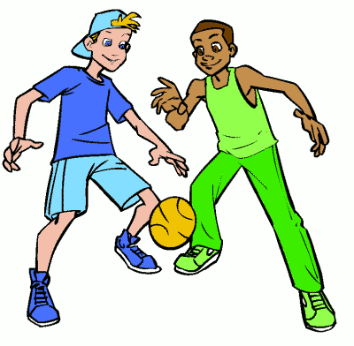
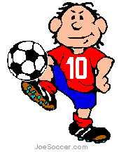
We are playing soccer.
Would you like to come?

Slide 8
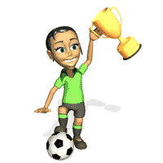
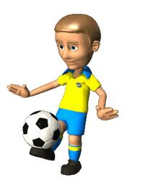
Yes, sure; if it’s okay.
I like soccer.
I’d like to play.

Slide 9
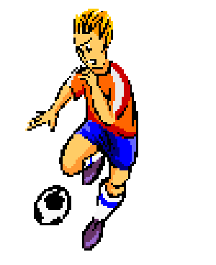
Yes, sure;
that sounds great.
I really cannot wait.

Slide 10
We are going to the zoo.
Can you join us?

Slide 11
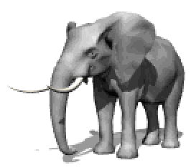
We are going to the zoo.
Would you like to come?

Slide 12
Oh, no. I can’t come.
I must go home and help my mum.

Slide 13
Oh, no. I can’t come.
I really must go home.

Slide 14
We are going swimming.
Can you join us?

Slide 15
We are going swimming.
Would you like to come?

Slide 16
Yes, sure; that sounds fun.
I like swimming.
I’d like to come.

Slide 17
Yes, sure;
that sounds great.
I really cannot wait.

