Slide 1
Lesson 13: It’s on the Chair

Slide 2
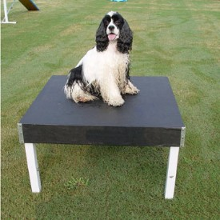
Where is the dog?

Slide 3
The dog is on the table.

Slide 4
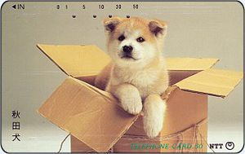
Where is the dog?

Slide 5
The dog is in the box.

Slide 6
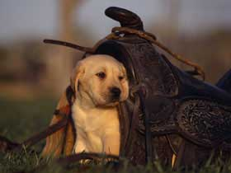
Where is the dog?

Slide 7
The dog is under the box.

Slide 8
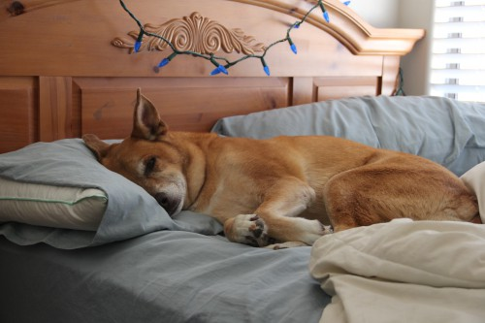
on

Slide 9
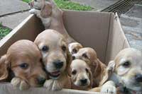
in

Slide 10
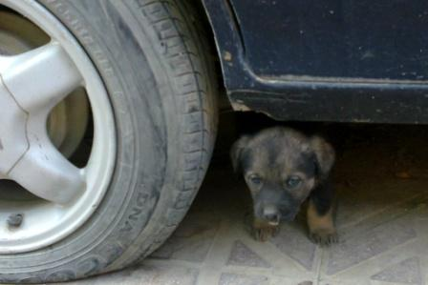
under

Slide 11
Where is the fish?

Slide 12
on
The fish is ___ the box.

Slide 13
in
The fish is ___ the box.

Slide 14
under
The fish is _____ the box.

Slide 15
Where is the gnome?

Slide 16
on
The gnome is ___ the drum.

Slide 17
in
box
The gnome is ___ the ____.

Slide 18
under
table
The gnome is_____ the ____.

Slide 19
Now, let’s make 3 sentences!
Where are you?
chair
I’m on a _____.
classroom
I’m in a _________.
roof
I’m under a _____.
Notes:
Where is the mouse/

