Slide 1
Review time!
Do you remember the past tense?
+ed

Slide 2
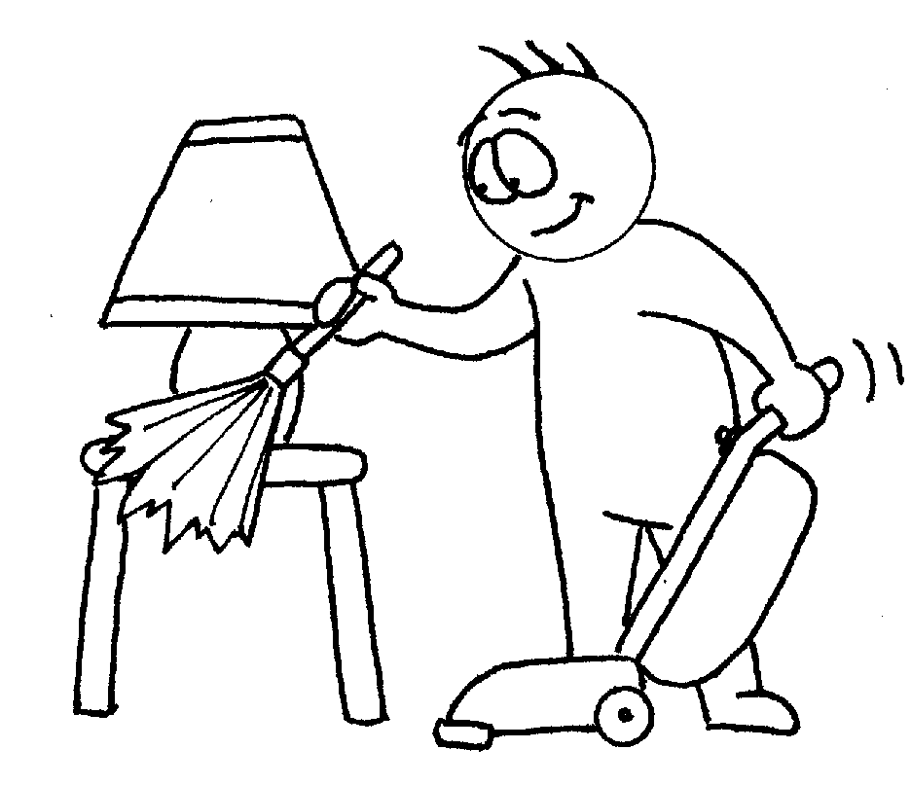
I cleaned my room.
Everyday, I clean my room.
Yesterday, _____________.
I cleaned my room.

Slide 3
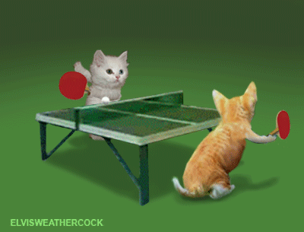
Everyday, I play ping pong.
Yesterday, _____________.
I played ping pong.

Slide 4
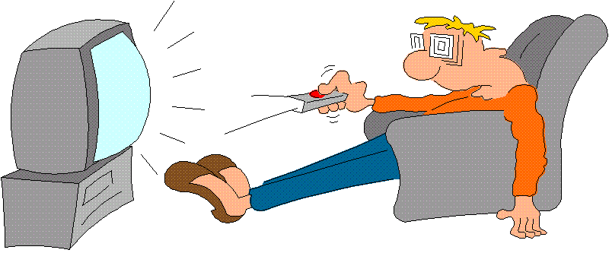
Everyday, I watch TV.
Yesterday, _____________.
I watched TV.

Slide 5
Everyday, I help Mom.
Yesterday, _____________.
I helped Mom.

Slide 6
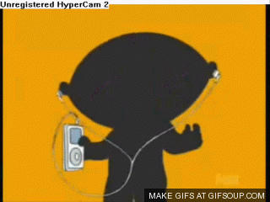
Everyday, I listen to music.
I listened to music.
Yesterday, _____________.

Slide 7
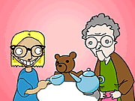
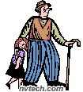
Everyday, I visit Grandma.
Yesterday, _____________.
I visited Grandma.

Slide 8
Do you remember these questions?

Slide 9
What did you do?

Slide 10
Where did you go?

Slide 11
Who did you see?

Slide 12
I’d like to know!

Slide 13
do = did

Slide 14
go = went

Slide 15
see = saw

Slide 16
What did you do?

Slide 17
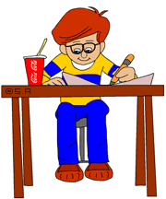
Everyday, I do my homework.
Yesterday, _____________.
I did my homework.

Slide 18
Where did you go?

Slide 19
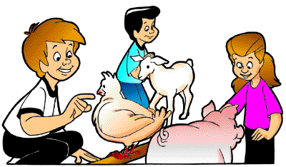
Everyday, I go to the zoo.
Yesterday, _____________.
I went to the zoo.

Slide 20
Who did you see?

Slide 21
Everyday, I see many things.
Yesterday, _____________.
I saw a ghost!

Slide 22
Great work!

