Slide 1
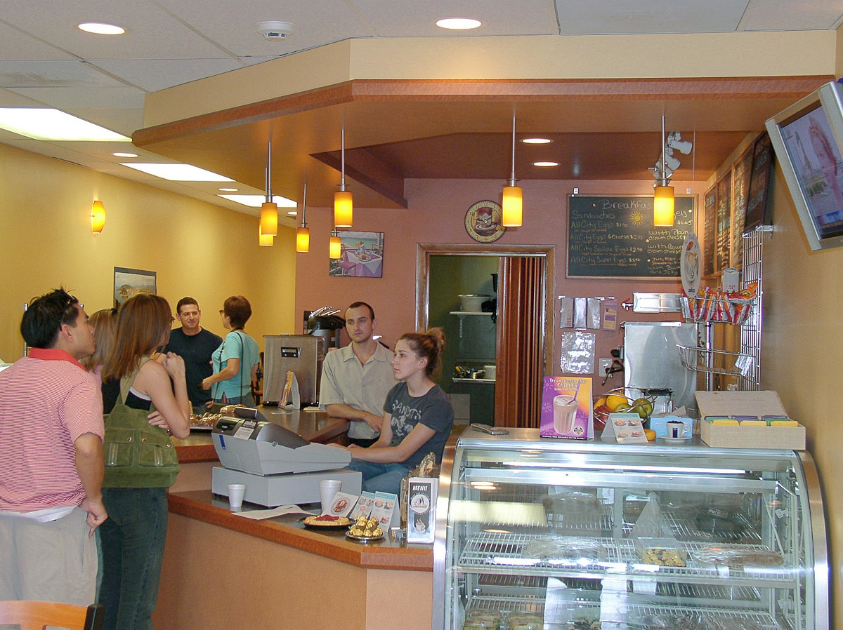
Let’s Buy Something!
I like this.
How much is it?
It’s ten dollars.
Here you are.
Thank you. Have a nice day!

Slide 2
Let’s Buy Something!
I like this.
How much is it?
It’s ten dollars.
Here you are.
Thank you.

