Slide 1
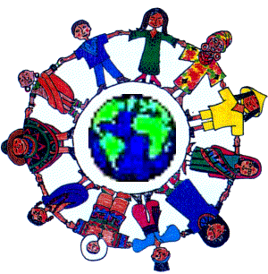
Around
the World

Slide 2
Money

Slide 3
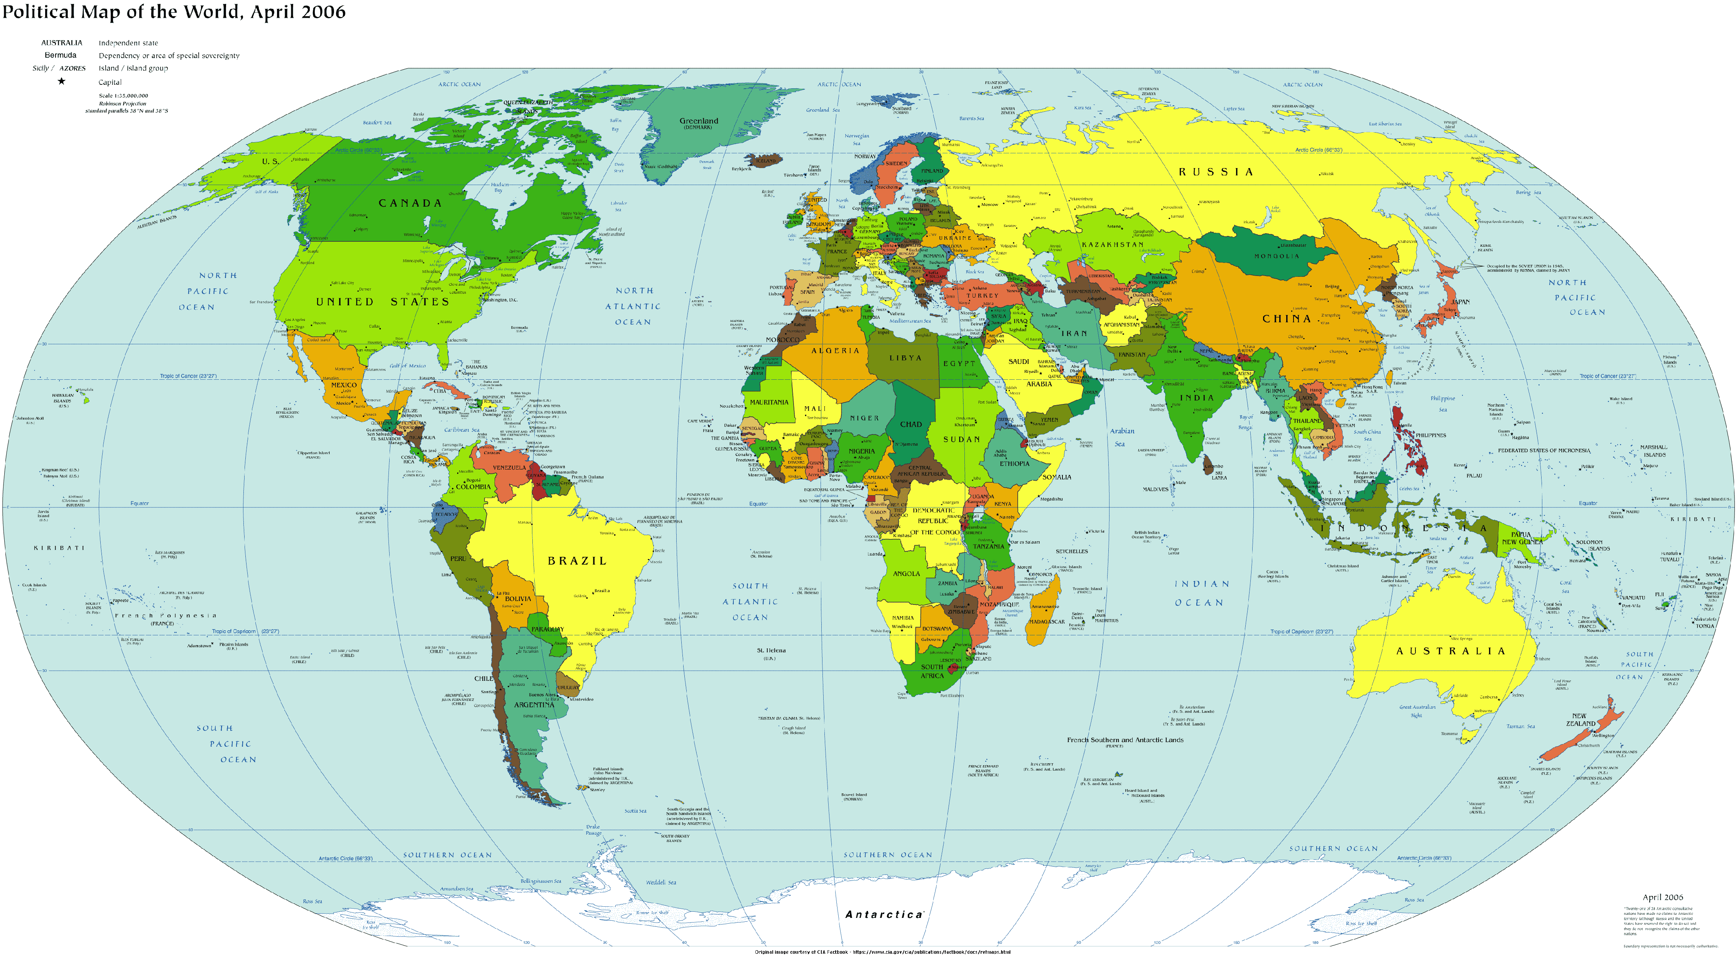
Today, we will explore…
England
U.S.A.
India
Philippines

Slide 4
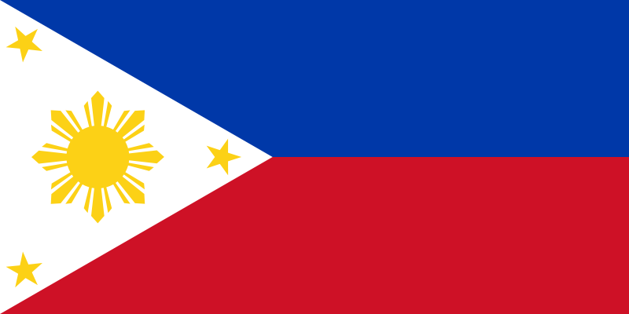
Philippines
Korea
Philippines

Slide 5
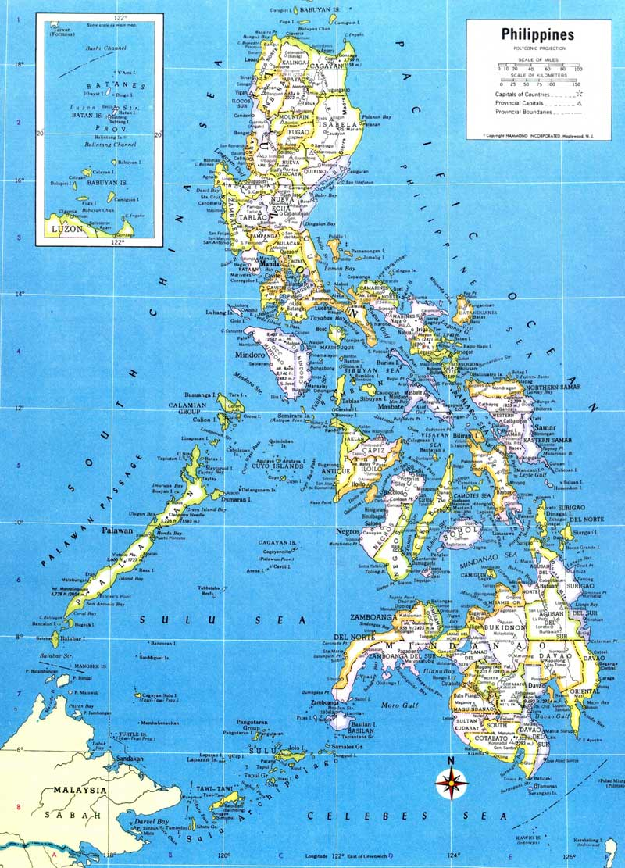
Philippines
The Philippines are made up of over 7,000 islands.

Slide 6
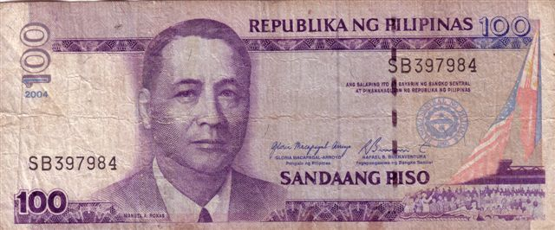
Philippine’s-
Pesos

Slide 7
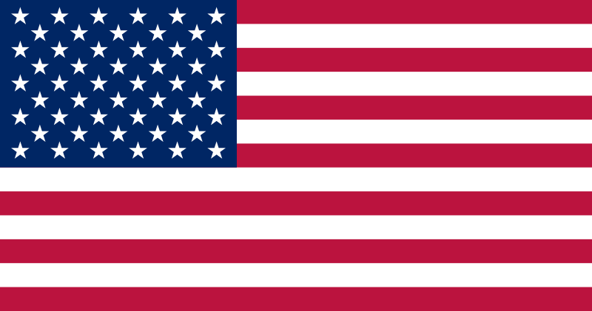
U.S.A
U.S.A.
Korea

Slide 8
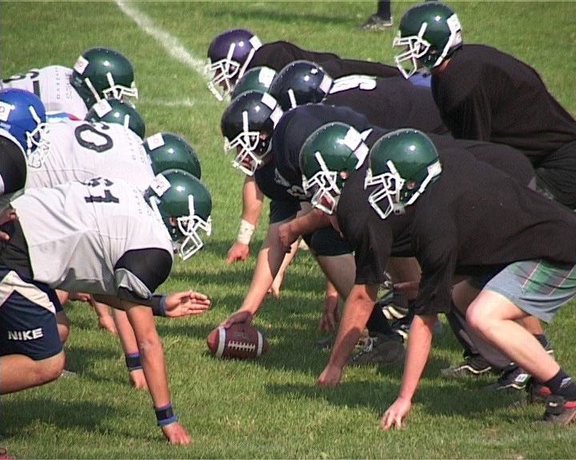
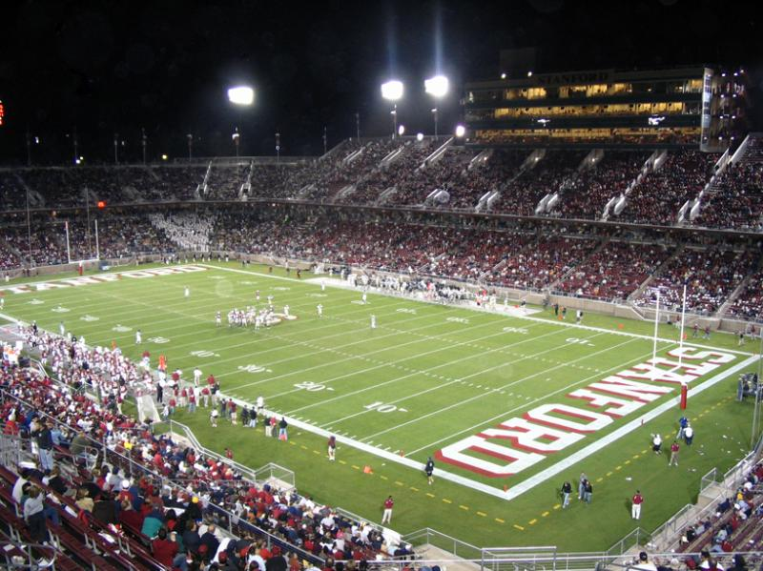
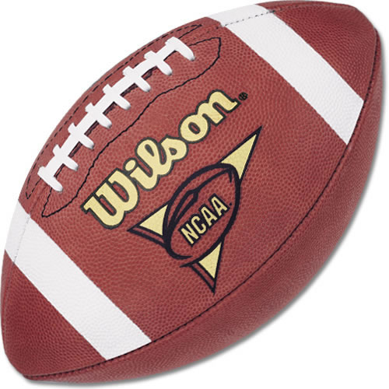
U.S.A.
That Americans call football ‘soccer’? This is what American football looks like.

Slide 9
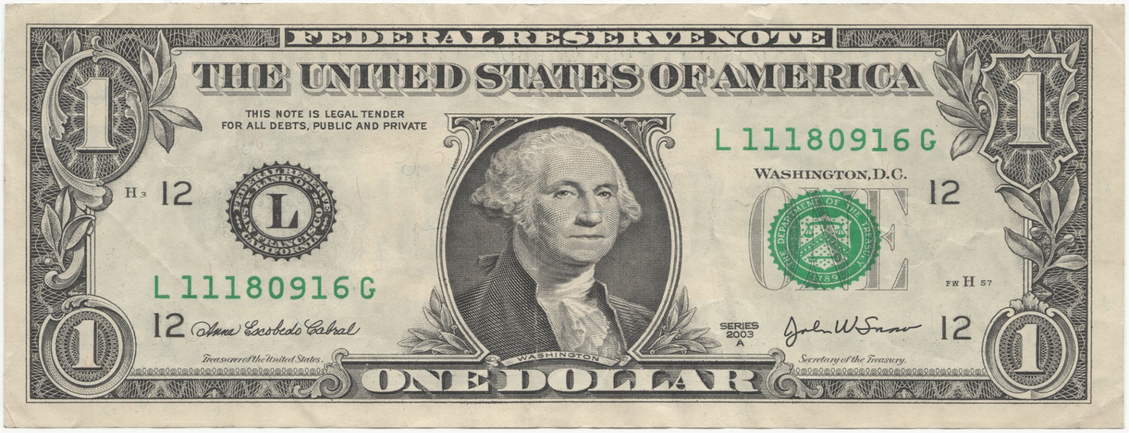
USA-
dollars

Slide 10
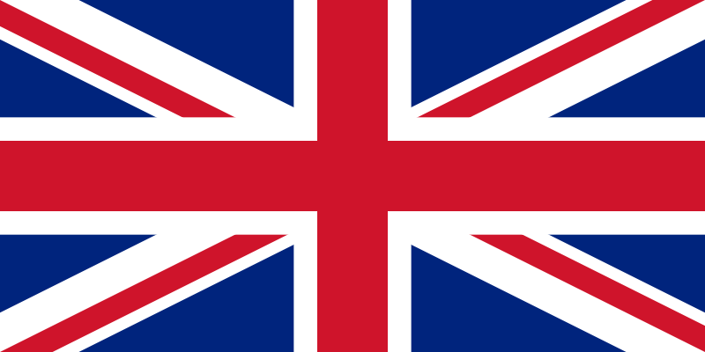
England
England
Korea

Slide 11
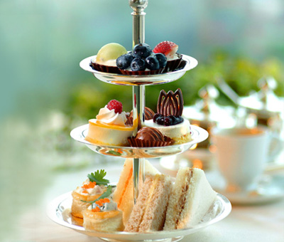
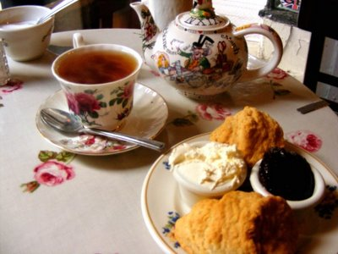
U.K.
An early dinner in the UK is also called high tea.

Slide 12
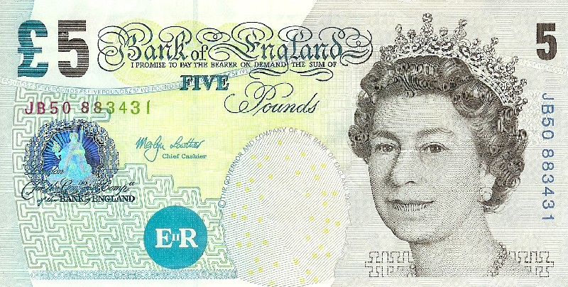
England-
pounds

Slide 13
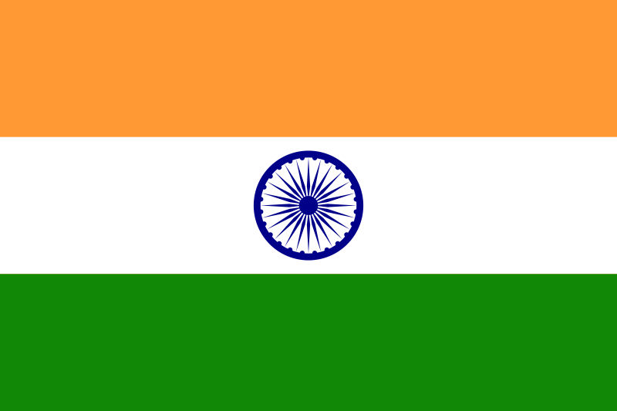
India
Korea
India

Slide 14
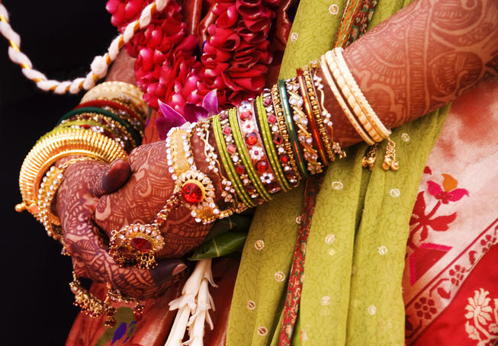
India
Indian women use henna to create beautiful designs on their skin. They are like temporary tattoos.

Slide 15
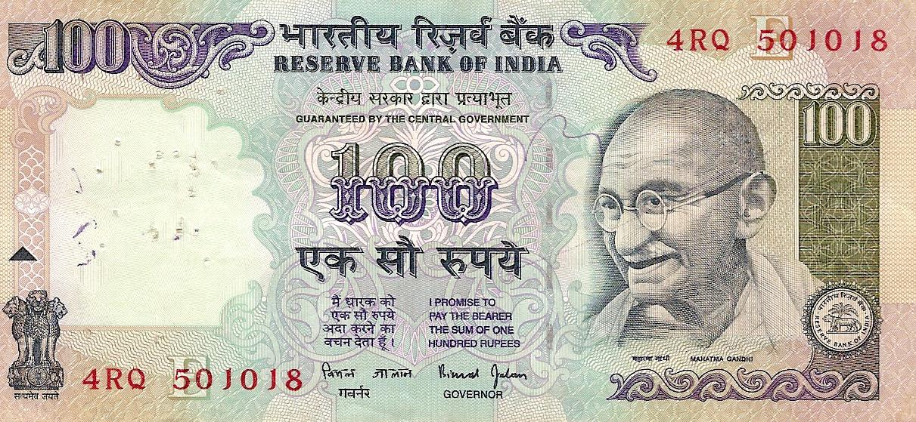
India-
rupees

Slide 16
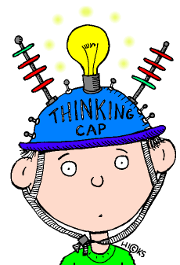
Quiz

Slide 17
Can you name the 4 countries we studied today?
The Philippines
England
USA
India

Slide 18
How many Islands make up the Philippines?
300 islands
40 islands
8000 islands
7000 islands

Slide 19
What is The Philippines' money called?
dollars
cents
pesos
pounds

Slide 20
What is ‘football’ called in the USA?
handball
soccer
monkeyball
bananaball

Slide 21
What is The USA’s money called?
dollars
rupees
pesos
pounds

Slide 22
What do English people call an early dinner?
high five
high tree
high tea
pounds

Slide 23
What is England’s money called?
dollars
rupees
pesos
pounds

Slide 24
Who has henna tattoos?
English people
Indian people
Philippine people
Irish people

Slide 25
What is India’s money called?
dollars
rupees
pesos
pounds

Slide 26
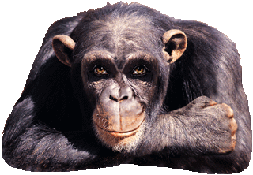
Good job!

