Slide 1
Is peter there?
Vocab

Slide 2
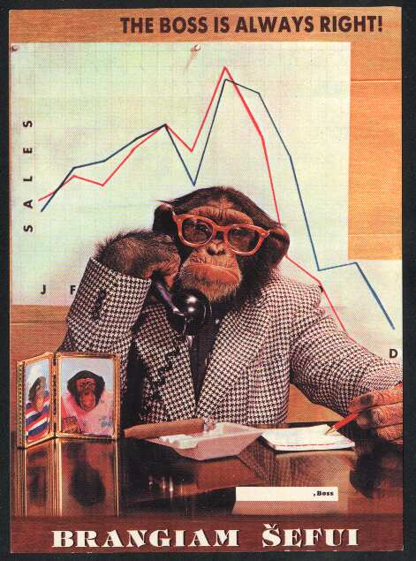
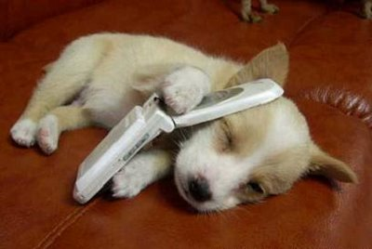
Hi puppy!
This is
Monkey!
Let’s meet at Home Plus at 5:00pm
Is this _______?
Is _____
there, please?
puppy
Yes, it is.
Speaking.
123-4567
Hi Monkey!
Sure, see you then!

Slide 3
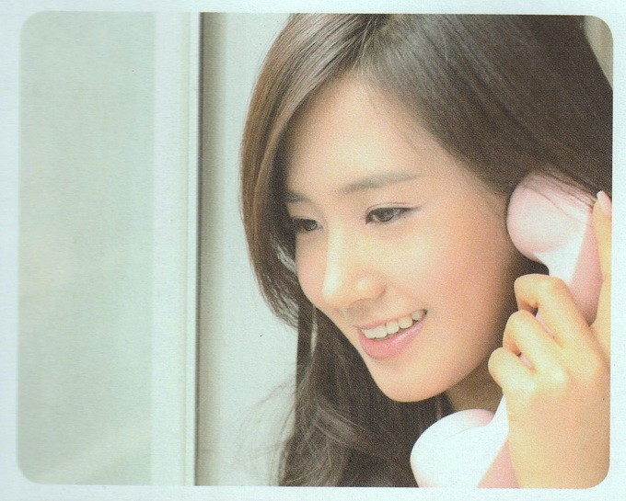
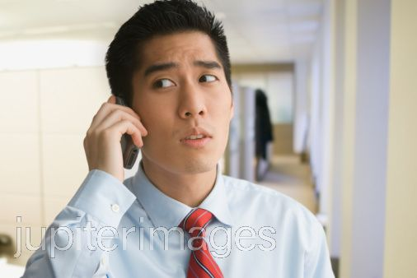
Speaking.
Hi Dong Chan!
Yes, it is.
Great, see you then!
Hi Yuri.
This is
Dong Chan!
Is ___ there, please?
Let’s meet at VIPS at
7:00pm!
Is this ________ ?
Yuri
010-2432

Slide 4
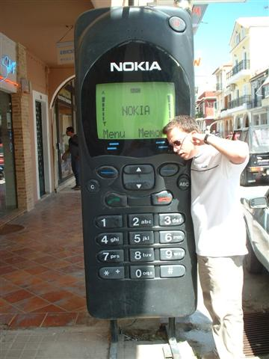
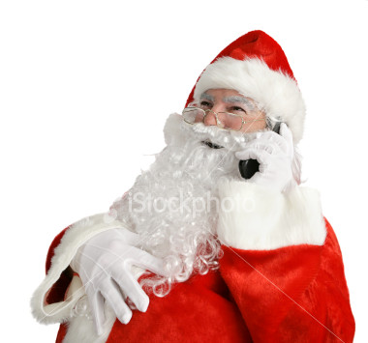
Is this
______?
Is ____
there,
please?
Hi Santa.
____ is
Roger!
Let’s _____ at
Shingok
Elementary School at 12:00am
Santa
meet
This
Yes, __ __.
Okay, see
you ____!
Speaking.
Hi Roger!
010-7201
it
is
then

