Slide 1
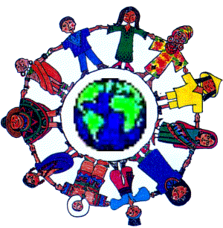
Around
the World

Slide 2
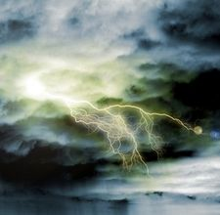
Extreme
Weather

Slide 3
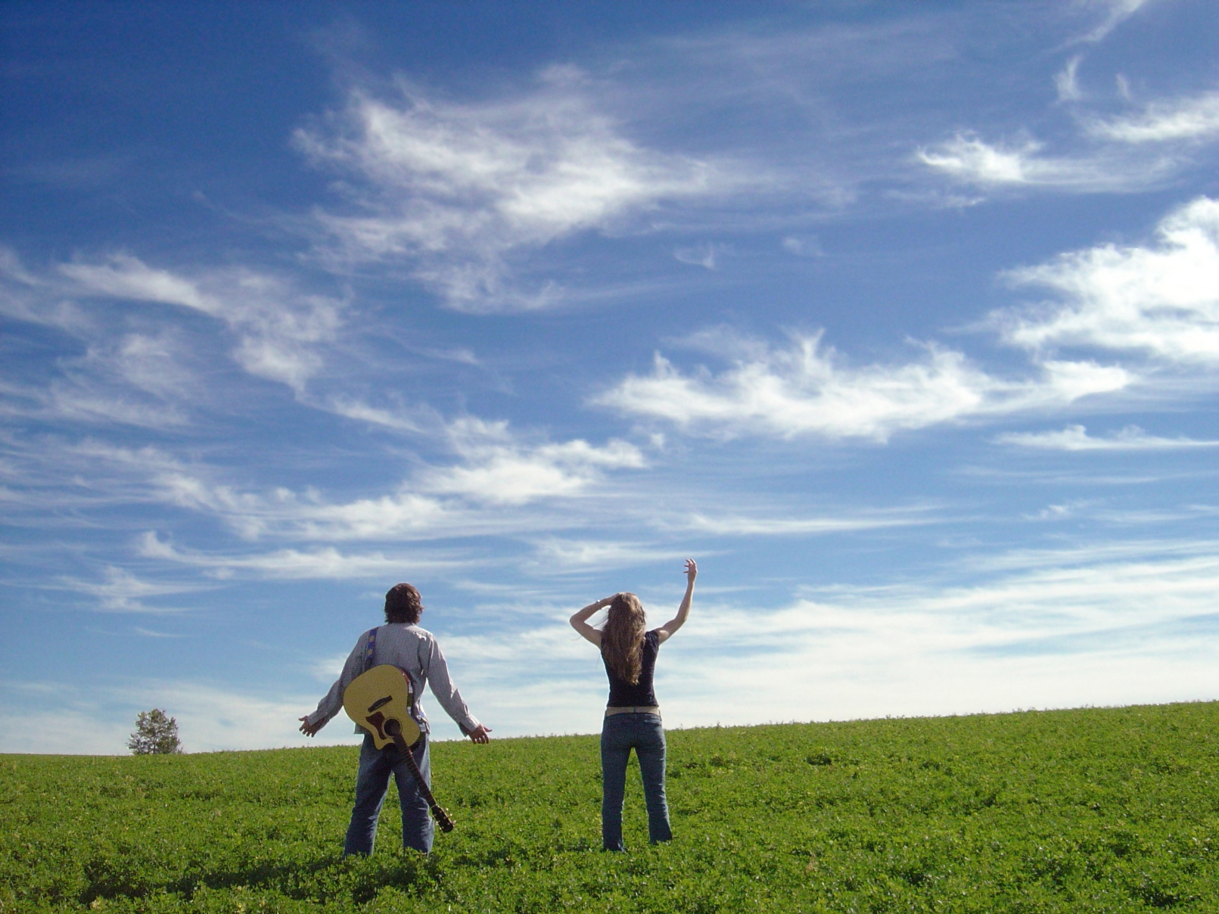
It’s hot!
In America: °F
The world: °C

Slide 4
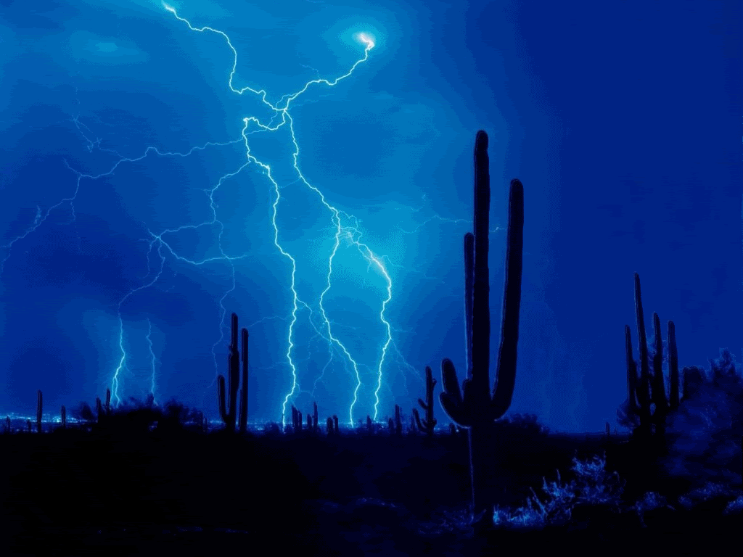
What is it?
It’s lightning in the desert.

Slide 5
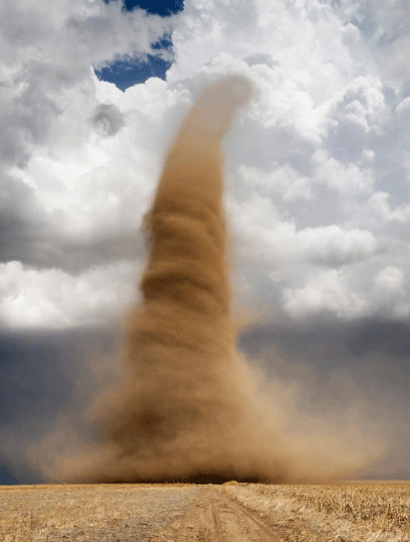
What is it?
Strong winds make up tornados.
It’s a tornado in the desert.

Slide 6
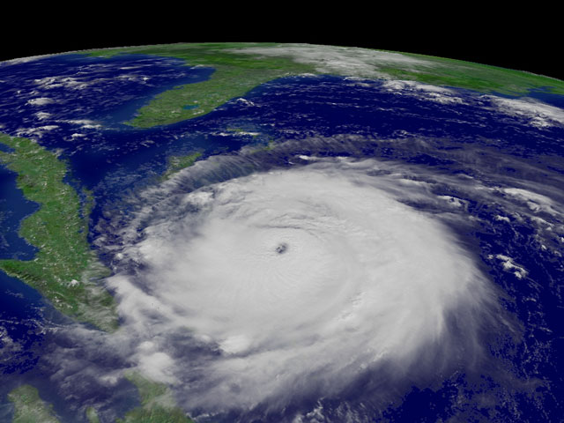
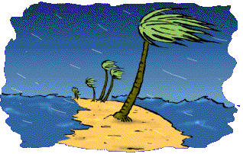
What is it?
It’s a hurricane in America or a typhoon in Asia.

Slide 7
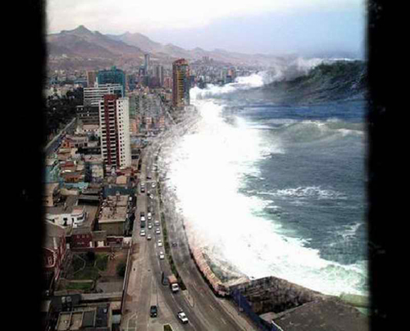
What is it?
Japan had a Tsunami this year!
It’s a tsunami.

Slide 8
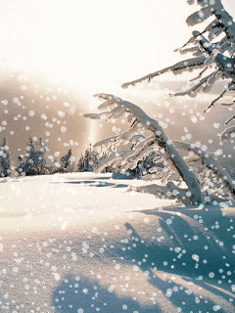
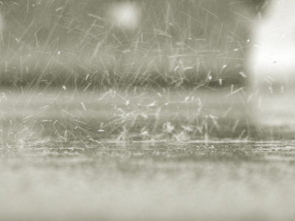
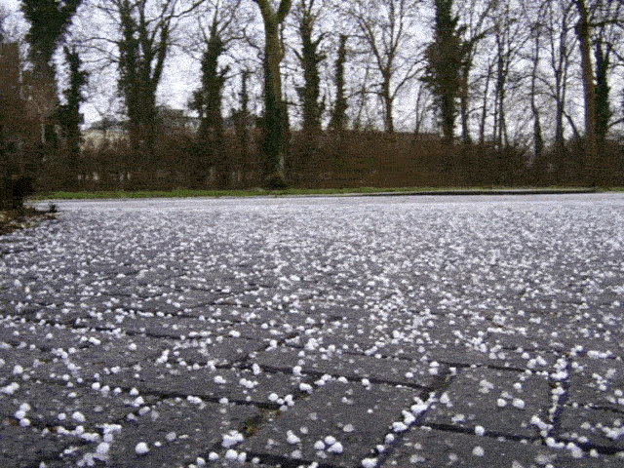
Storms

Slide 9
It’s a thunder storm.

Slide 10
snow
It’s a _____ storm.

Slide 11
rain
It’s a _____ storm.

Slide 12
hail
It’s a _____ storm.

