Slide 1
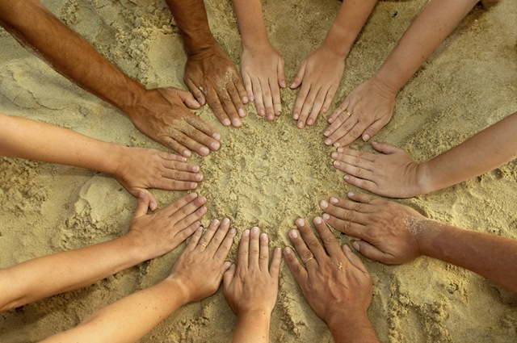
Do You Want
Some More?
Grade 5
Lesson 10

Slide 2
knife

Slide 3
chopsticks

Slide 4
spoon

Slide 5
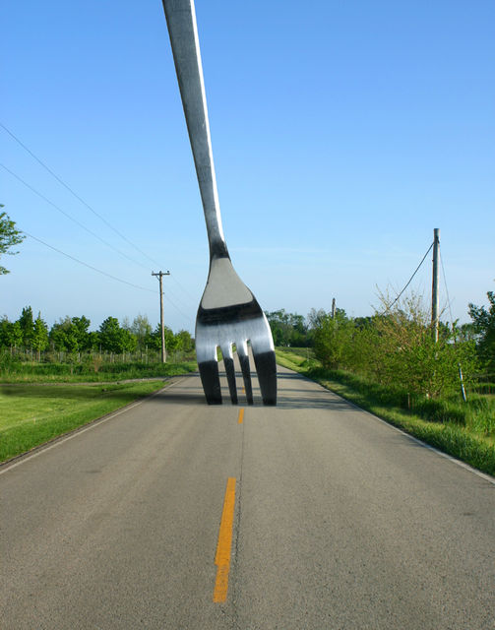
fork

Slide 6
plate

Slide 7
cup

Slide 8
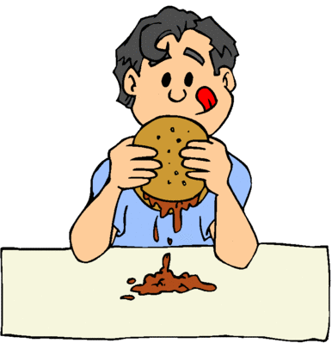
Yes,
please!
-It’s yummy!

Slide 9
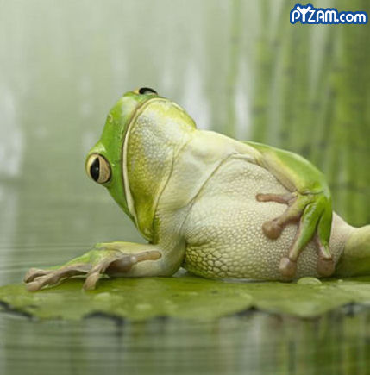
No,
thank
you!
-I’m
full!

Slide 10
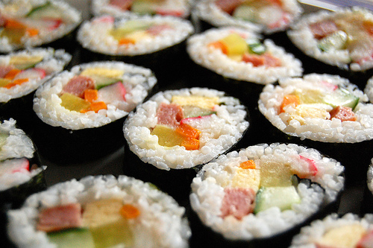
Do you want some
more
kimbab?
Yes, please.
No, thank you.

Slide 11
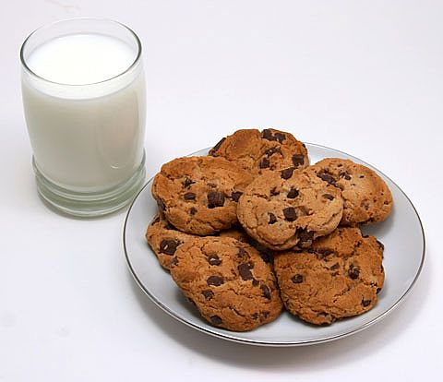
Do you
want some
more
milk and
cookies?

Slide 12
Do you want
some more
cake?

Slide 13
Do you want some more
pizza?

Slide 14
Do you want some more rice?

Slide 15
Do you want some more songpyeon?

Slide 16
Do you want some more water?

Slide 17
Do you want some more candy?

Slide 18
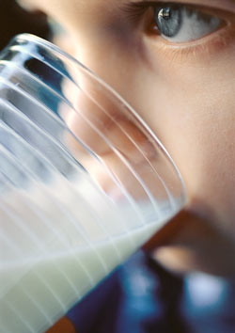
Can I have some more milk?
Help yourself!

Slide 19
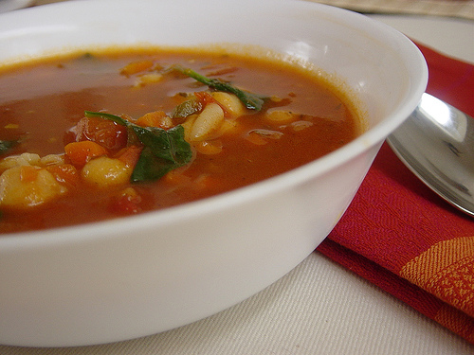
Help yourself!
Can I have some more soup?

Slide 20
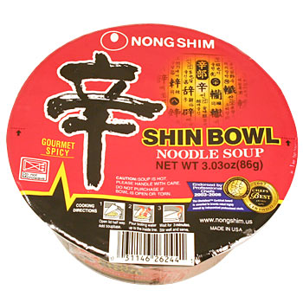
Can I have some more ramen?
Go ahead!

Slide 21
Oh!....
I’m so
full.

Slide 22
Do you want some
more…?
Yes, _____. It’s _______!
No, _____ ____. I’m _____!

